Slide 1
Recitation Class Ch9 ,Ch12
Yijin Rui
University of Michigan – Shanghai Jiao Tong University Joint Institute, Shanghai Jiao Tong University, China
Email: iregion@sjtu.edu.cn

Slide 2
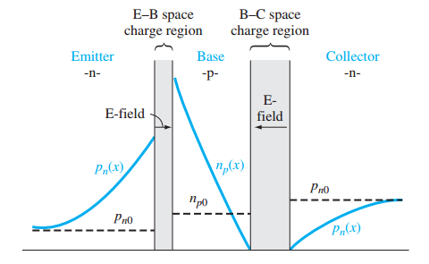
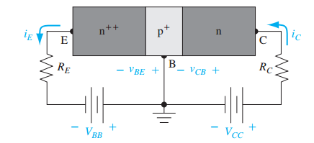
Ch12 BJT
The Basic Principle of Operation

Slide 3
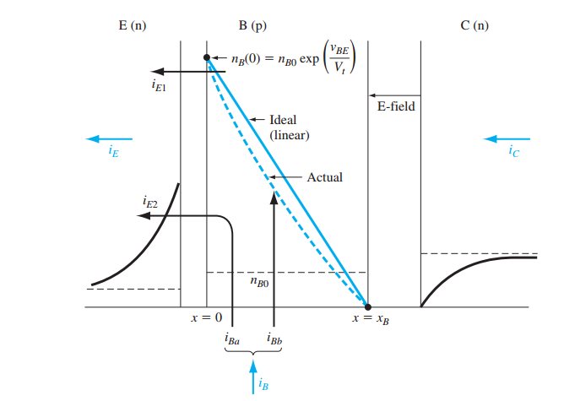





Simplified Transistor Current Relation

Slide 4
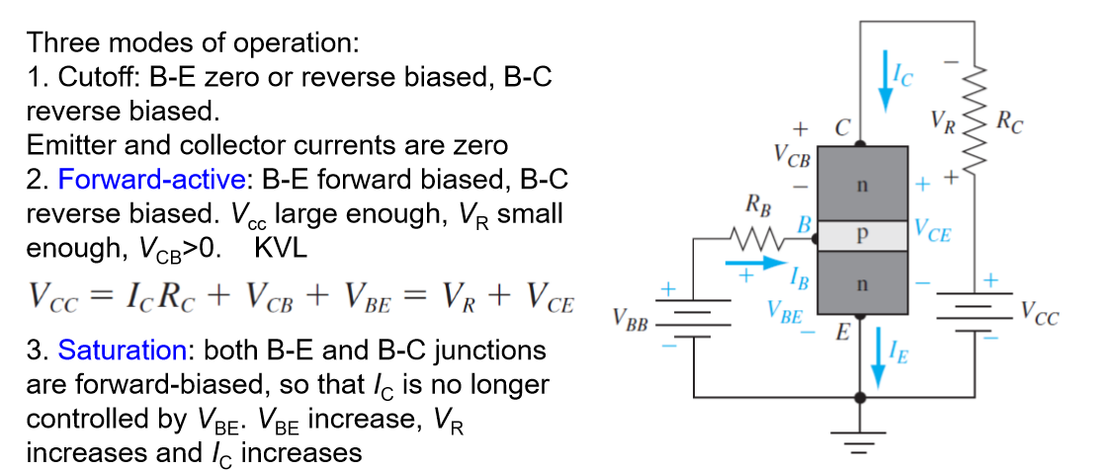
The Modes of Operation

Slide 5
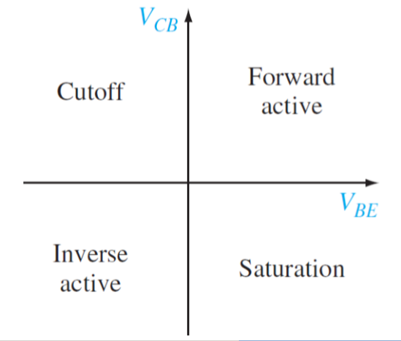
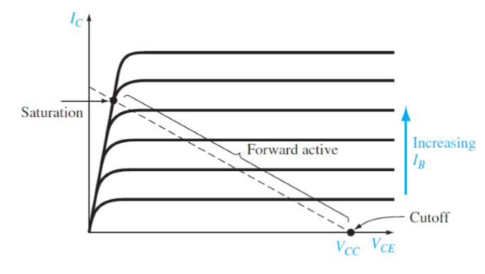

Slide 6
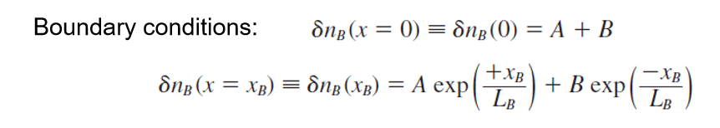
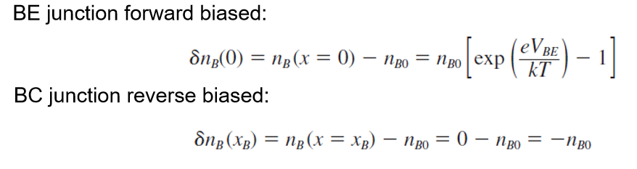
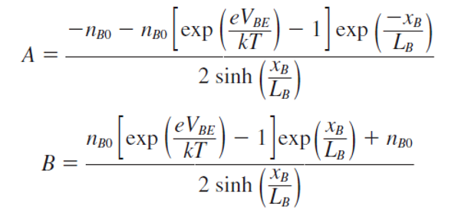
Minority carrier distribution

Slide 7
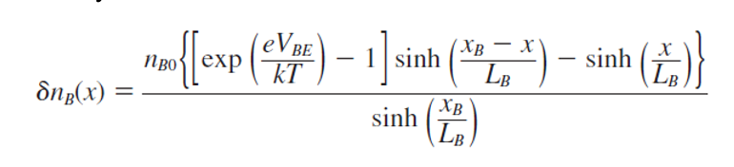
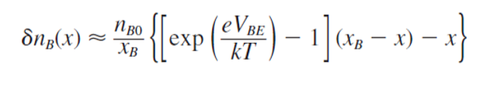

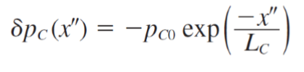
For emitter and collector region

Slide 8
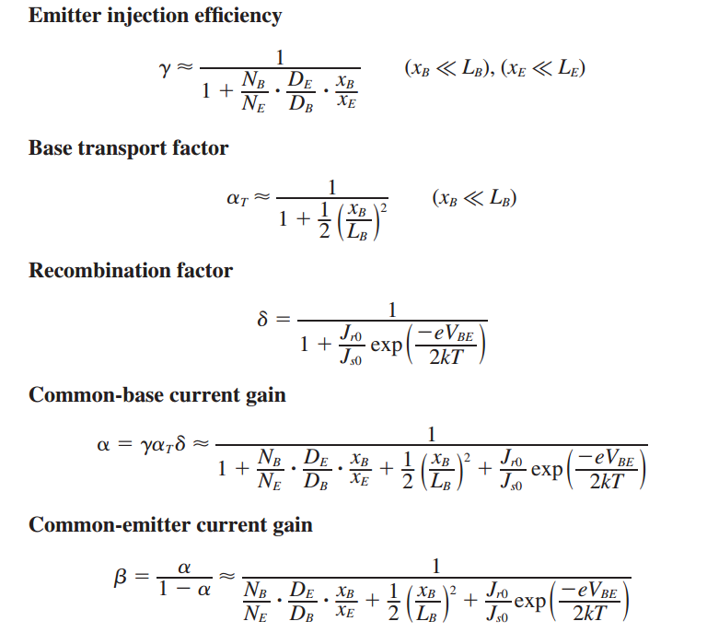
Current Gain

Slide 9
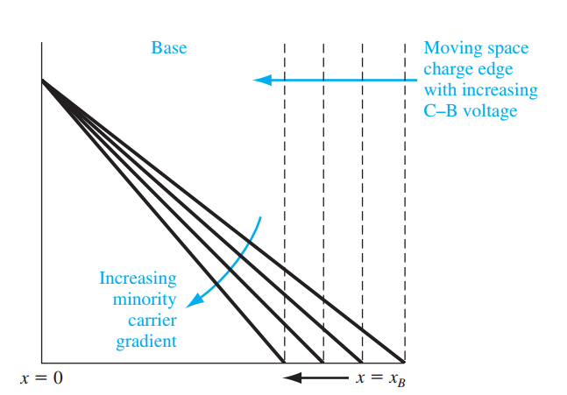
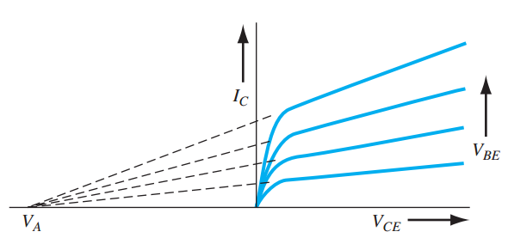

Early effect (Base Width Modulation)

Slide 10
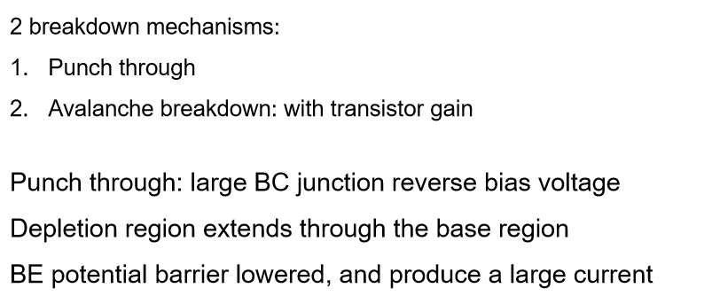
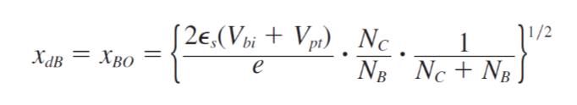
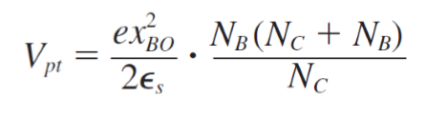
Breakdown

Slide 11
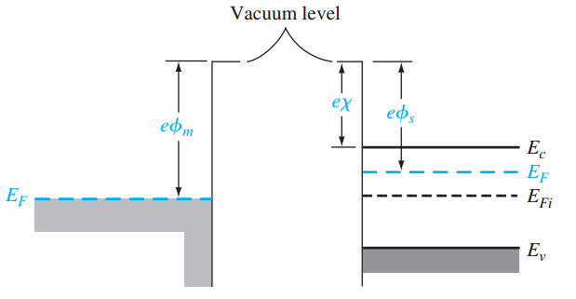
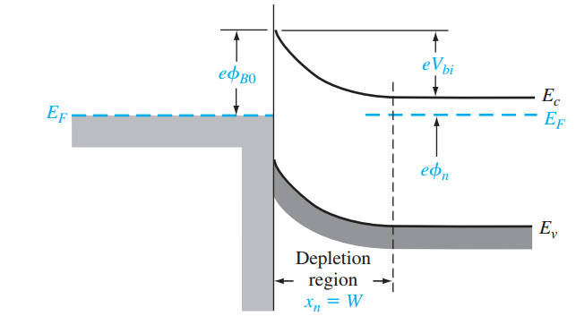



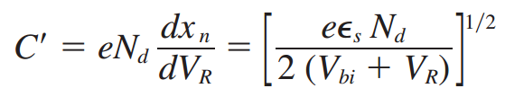
Ch9 Schottky Contact
Work function and electron affinity

Slide 12
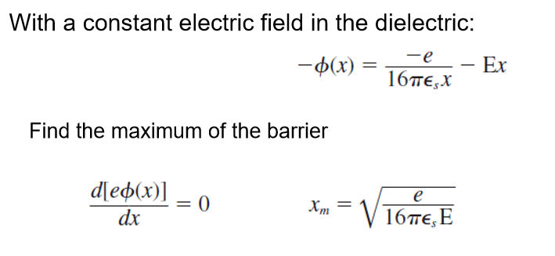

Nonideal effects
Schottky effect
Interface states
Since the surface state density is not predictable with any degree of certainty, the barrier height must be an experimentally determined parameter

Slide 13






Current–Voltage Relationship
Considering Image-force lowering

Slide 14

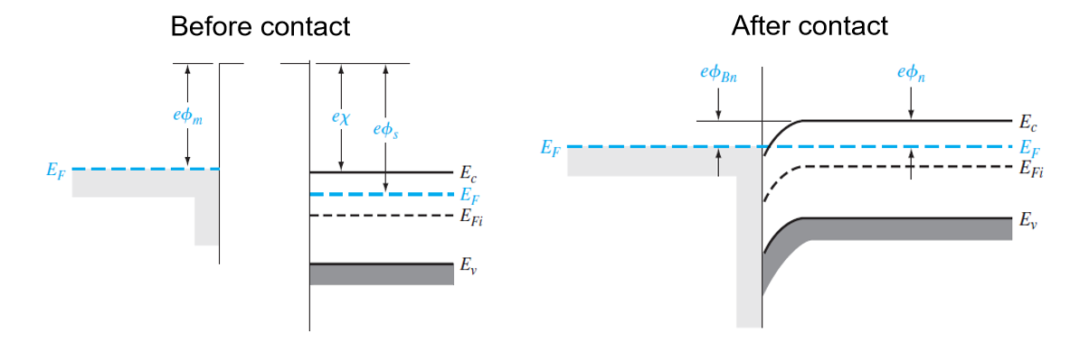
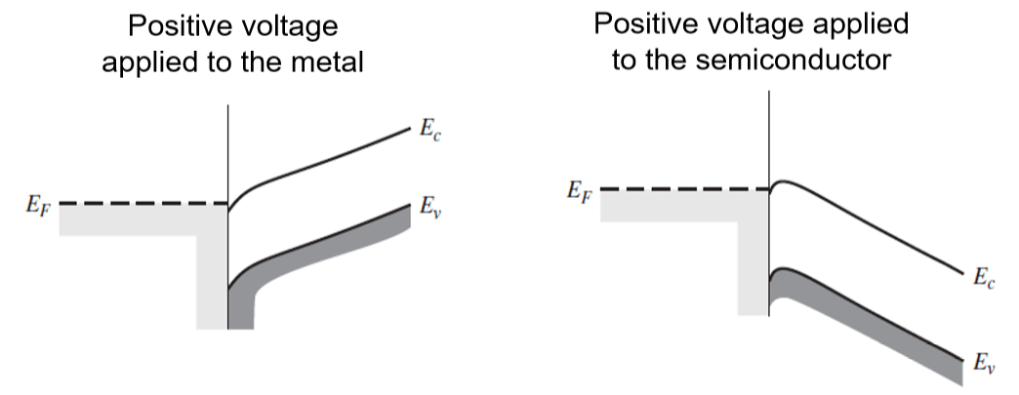
Ohmic contacts

Slide 15
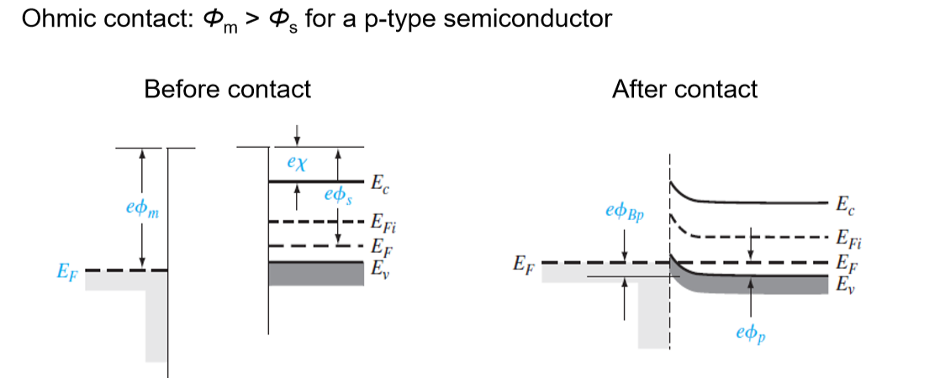

Slide 16
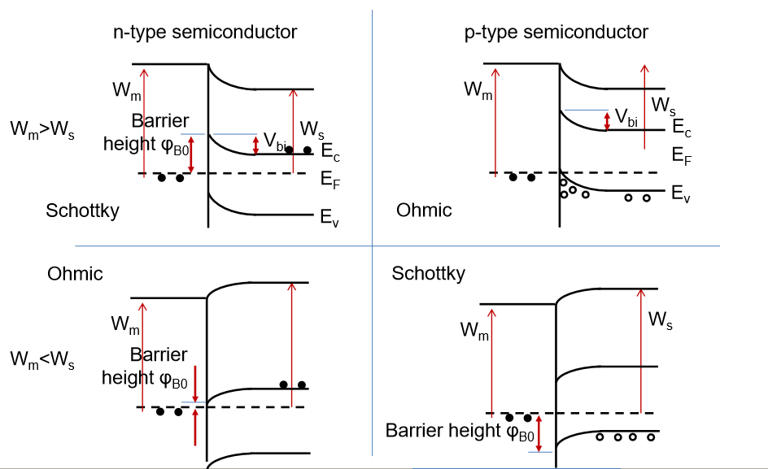

Slide 17
Thank you!

